Slide 1
Statistical analysis of ECG signal for myocardial ischaemia
Group Members:
Madhurima Purkait
Pratyusha Sinha
Subrata Sarkar
Sneha Tiwari

Slide 2
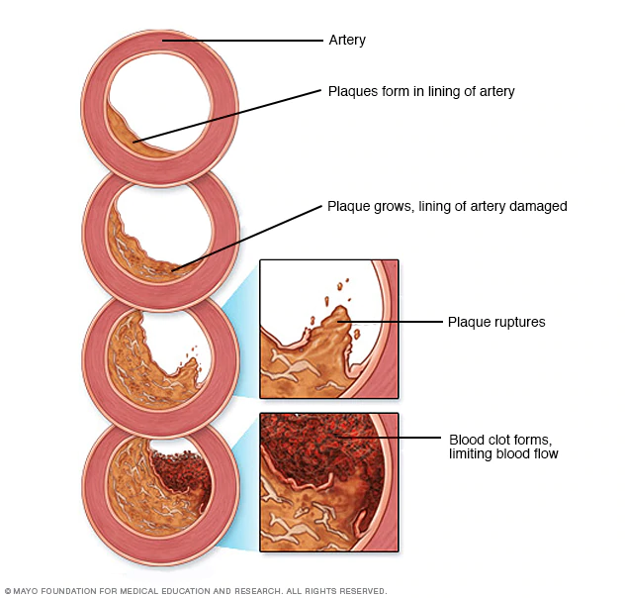
Introduction:
Myocardial ischemia occurs when blood flow to the heart is reduced, preventing the heart muscle from receiving enough oxygen. The reduced blood flow is usually the result of a partial or complete blockage of the heart's arteries (coronary arteries).
Myocardial ischemia, also called cardiac ischemia, reduces the heart muscle's ability to pump blood. A sudden, severe blockage of one of the heart's artery can lead to a heart attack. Myocardial ischemia might also cause serious abnormal heart rhythms.
Symptoms:
Some people who have myocardial ischemia don't have any signs or symptoms (silent ischemia).
Signs and symptoms which might be experienced :
chest pressure or pain(typically on the left side of the body)
Neck or jaw pain
Shoulder or arm pain
A fast heartbeat
Shortness of breath when you are physically active
Nausea and vomiting
Sweating
Fatigue
Causes: Conditions that can cause myocardial ischemia include:
Coronary artery disease (atherosclerosis). Plaques made up mostly of cholesterol build up on your artery walls and restrict blood flow.

Slide 3
Blood clot. The plaques that develop in atherosclerosis can rupture, causing a blood clot.
Coronary artery spasm(Uncommon Cause). This temporary tightening of the muscles in the artery wall can briefly decrease or even prevent blood flow to part of the heart muscle.
Chest pain associated with myocardial ischemia can be triggered by:
1.Physical exertion 2.Emotional stress 3.Cold temperatures 4.Cocaine use 5.Eating a heavy or large meal
6.Sexual intercourse
Risk factors:
1.Tobacco 2.Diabetes 3.High blood pressure 4.High blood cholesterol level 5.High blood triglyceride level 6.Obesity Waist circumference 7.Lack of physical activity
Complications:
Heart attack
Irregular heart rhythm (arrhythmia)
Heart failure
Treatment:
Treatment for myocardial ischemia involves improving blood flow to the heart muscle. Treatment may include medications, a procedure to open blocked arteries (angioplasty) or bypass surgery.

Slide 4
Electrocardiogram (ECG):
Our nerve and muscle cells communicate with each other using electrical and chemical signals. Regular electrical signals also control our heartbeat. These signals are sent by a group of cells in the right atrium of the heart known as the sinoatrial node (SA node), and they spread through the heart muscle tissue as tiny electrical impulses. This causes first the atria and then the ventricles of the heart to contract. The way that these signals spread through the heart can also be measured on the surface of our skin. An ECG measures these changes in electrical signals (or, in fact, voltage) on different areas of skin and plots them as a graph. The resulting ECG graph is called an electrocardiogram.
It mainly records how often the heart beats (heart rate) and how regularly it beats (heart rhythm).
The ECG Test Involves:
The electrical activity of the heart can be measured on the surface of the skin – even as far from the heart as on the arms or legs. The standard “12-lead ECG” uses a total of ten electrodes: six on your chest, and then one each on the lower arms and calves.
Types of ECG tests:
Resting ECG: This involves lying still on your back with a bare chest.
Exercise ECG: Here the electrical activity of your heart is measured while you are physically active.
Holter monitor: The electrical activity of the heart is typically recorded over a period of 24 hours. Three or four electrodes are attached to your chest, and a small recording device is worn on a belt or hung around your neck.
The results of a 12-lead ECG show:
The 12-lead ECG takes advantage of the fact that signals sent by the heart don't travel evenly over the skin. The device compares the strength of the signals between two electrodes called “leads.”

Slide 5
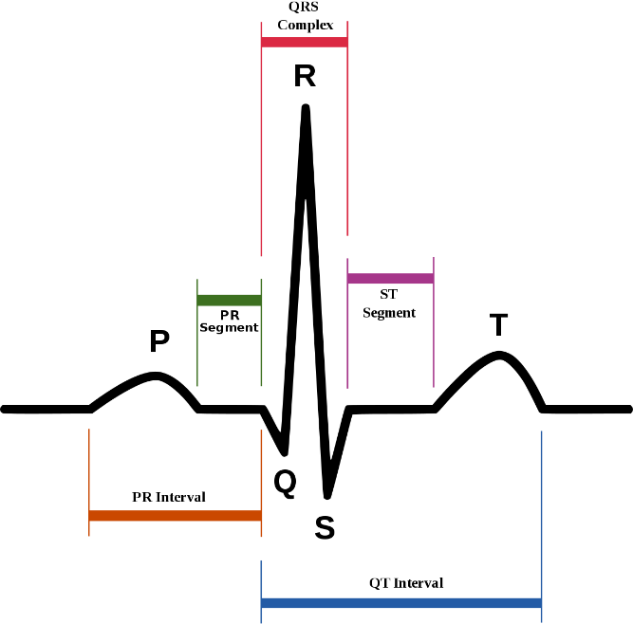
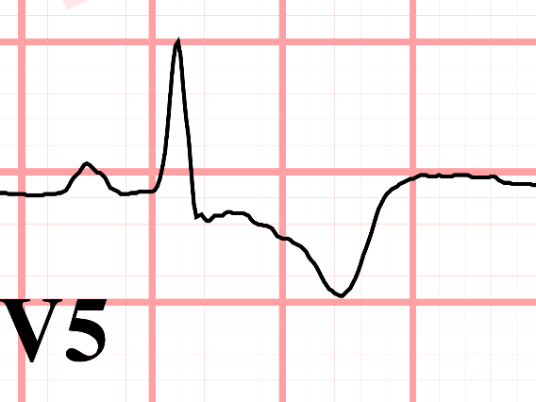
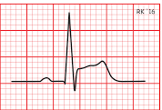
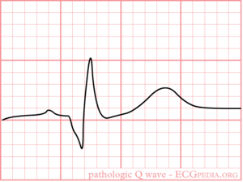
For example, one of the leads is measured based on the two electrodes on your arms. A 12-lead ECG, as its name implies, is used to measure twelve leads. Depending on which lead shows irregularities, experts can find out things like in which part of the heart muscle an infarction has occurred, or whether a heart rhythm problem is coming from the left or right ventricle.
In Myocardial Infraction changes in ECG are:
ST segment elevation.
T wave inversion
Appearance of wide deep Q waves.
T wave inversion
ST Segment Elevation
Wide deep Q waves
Normal ECG
Abnormal ECG

Slide 6
Previous Work
https://www.banglajol.info/index.php/BJMP/article/download/39147/26626
They used ST slope for classification of ECG segments
https://link.springer.com/article/10.1007/s10489-018-1179-1
They took images of ECG signal and fed it to a CNN and predicted whether the segment was normal or not.

Slide 7
Detailed description of labelling the data
As we found out in the paper published by University of Dhaka that ST slope can be used for classification of ECG wave segment and then use the slope data as condition for the classification
We found out that in our dataset that the S-T segment lied between the R peak+15 time slice and R peak+45 time slice. Also Q and S point detection was easy as we needed to find the point of deflection tothe left and right of the R peak respectively
Inspired by the S-T slope classification of ECG signal, with the suggestion and the guidance of our faculty(Mr. Bimal Pal), we calculated the QRS angle and observed the value of the angle madeby QRS for both classes of data, with the help of which we wished to find out any abnormality in the ECG waveforms if the value of QRS angle differentiates from a particular range.

Slide 8

Labelling of data for CNN
We took four European-st-t-database records, e0103,e0104,e0105 and e0108 respectively.
In each data set we run a code where the dataset is divided into segments having 240 data point each(a typical heart rate has 70 to 75 beats per minute, i.e. each cardiac cycle takes about 0.8 seconds to complete the cycle).
During each interval, a pqrst wave is generated of that particular interval and thereafter we label our data according to the shape of the graph.
We label the data as 1 when the shape of the graph does not match with the general shape of pqrst wave and 0 otherwise.
And the data recorded in csv file.
After performing the same on each of four records , we got 2891 normal and 1294 abnormal pqrst segments.

Slide 9
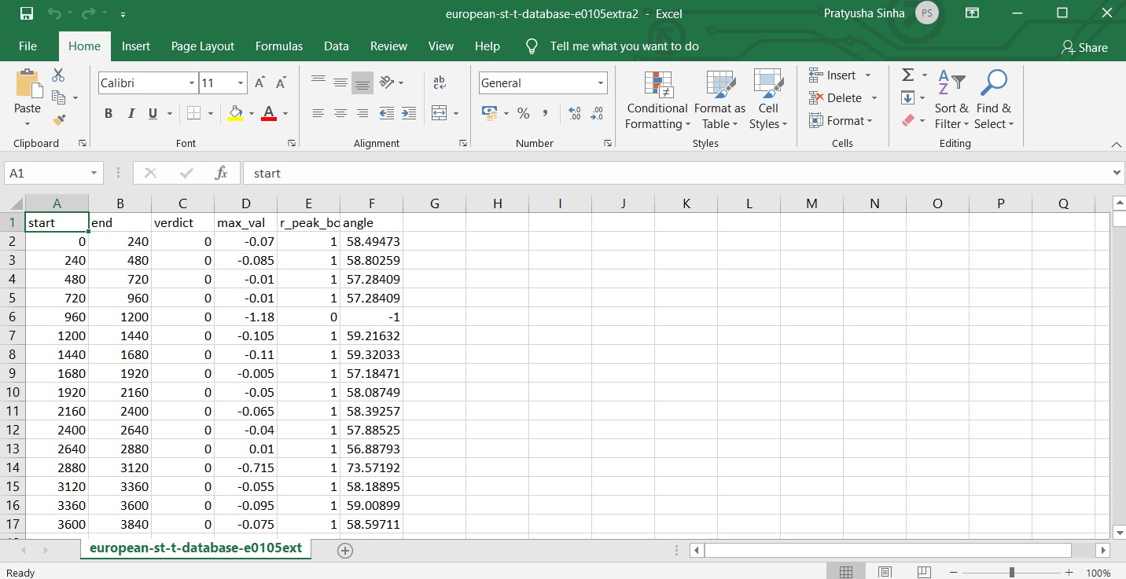
Measuring the angle value of r peak of abnormal segments.
After labelling the datasets, we decide to calculate the angle and amplitude of the peak of segments having r peak and store the value in csv file.
In the given figure, we calculated the angle value of normal pqrst waves.
In row 6, we can see that the r peak value is 0, when the peak is too low as compared to others. In such condition, we place value of angle as -1.
The normal value range of r peak is found to be between 56-59.
If the value of angle is greater than 59 and less than 56, then the particular qrst wave is found to be an abnormal ECG segment.

Slide 10
1D CNN model
ECG abmormality recognition is the problem of classifying sequences of ECG data recorded by ECG recording device as electrical impulses.
Classical approaches to the problem involve hand crafting features from the time series data based on fixed-sized windows and training machine learning models, such as ensembles of decision trees. The difficulty is that this feature engineering requires deep expertise in the field.
Recently, deep learning methods such as recurrent neural networks and one-dimensional convolutional neural networks, or CNNs, have been shown to provide state-of-the-art results on challenging activity recognition tasks with little or no data feature engineering, instead using feature learning on raw data.
So we developed one-dimensional convolutional neural networks for time series classification on the problem of ECG abnormality recognition

Slide 11
Architecture of the custom model we developed

Slide 12
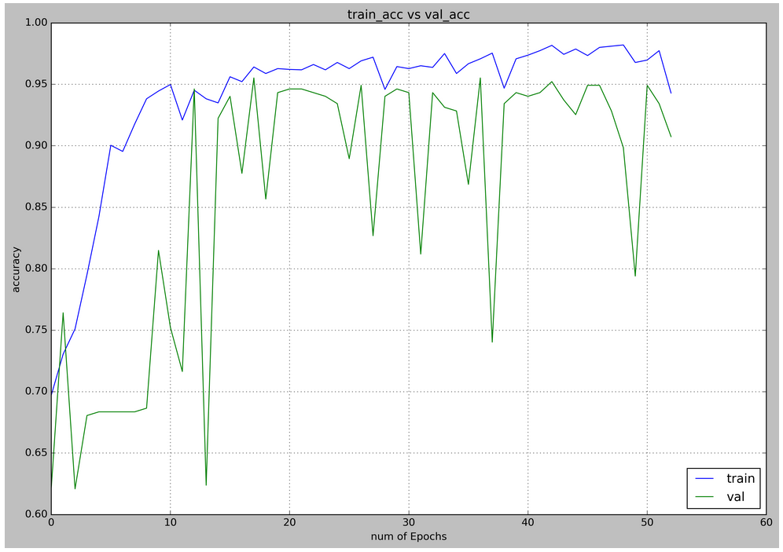
Model train accuracy curve

Slide 13
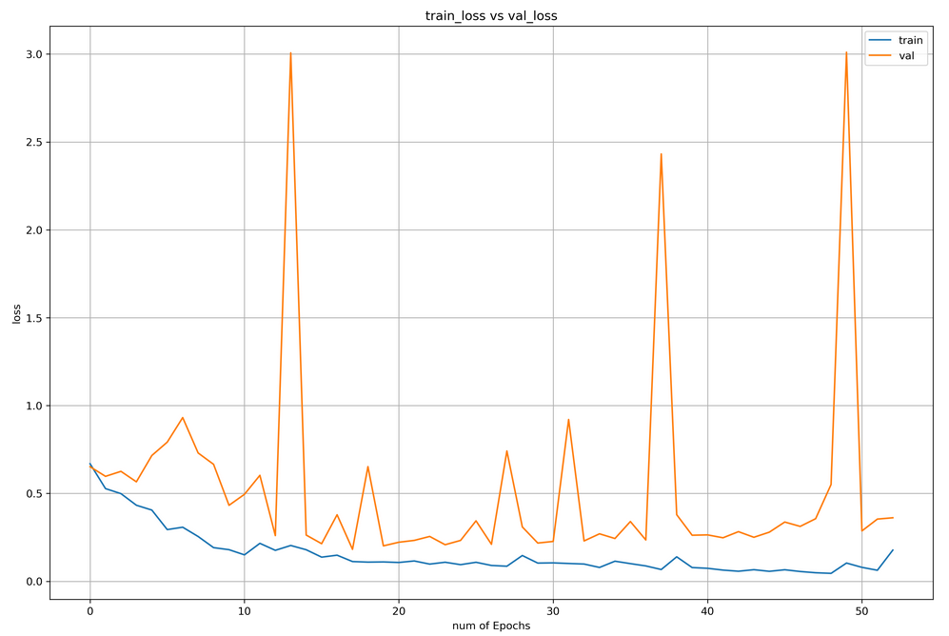
Model train loss curve

Slide 14
Metrics of the model on test data
The dataset has total 4185 samples of ECG and the train:validation:test is split as 0.7:0.1:0.2
Confusion matrix, without normalization:
abnormal [233 26]
normal [ 11 567]
abnornal normal
Measure | Value | Derivations
Sensitivity | 0.8996 | TPR = TP / (TP + FN)
Specificity | 0.9810 | SPC = TN / (FP + TN)
Precision | 0.9549 | PPV = TP / (TP + FP)
Negative Predictive Value | 0.9562 | NPV = TN / (TN + FN)
False Positive Rate | 0.0190 | FPR = FP / (FP + TN)
False Discovery Rate | 0.0451 | FDR = FP / (FP + TP)
False Negative Rate | 0.1004 | FNR = FN / (FN + TP)
Accuracy | 0.9558 | ACC = (TP + TN) / (P + N)
F1 Score | 0.9264 | F1 = 2TP / (2TP + FP + FN)
Matthews Correlation Coefficient | 0.8957 | TP*TN - FP*FN / sqrt((TP+FP)*(TP+FN)*(TN+FP)*(TN+FN))

Slide 15
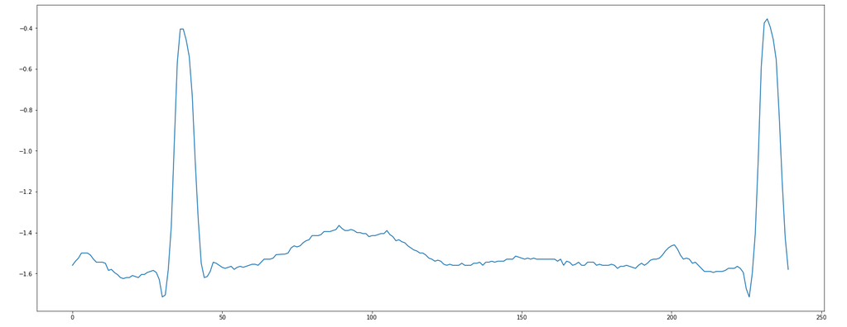
Test with individual manual input
On the left we have a abnormal ECG where the S point is high and also the st segment is flattened.
Real result: class 1(abnormal) predicted: class 1(abnormal)

Slide 16
Future Scope
Better accuracy – These model is based on extensive samples and trained by datas fed to it. More number of samples will improve the efficiency and accuracy of the model. There is always scope for improvement.
Better explainability using QRS angles – While using this CNN model, 1D array of data points are fed as input. The CNN is like a black box giving prediction on the fed ECG signal which lacks explainability from medical point of view. That is why value of QRS angle again serves a purpose. Value of QRS angle can be associated with the output of CNN model to explain the reports much better as the pattern of QRS angle is easily visible in the waveform.
Better training data by validating the training data with the help of professionals – While labelling the particular part of waveforms, incorrect labelling may have happened and that can effect the efficiency of the model as we are mot medical professionals and the waveforms are primalrily manually labelled by observing the patterns. So if that can be done with the help of professionals, the probability of wrong labelling can be reduced to much greater extent which will surely be better training data.Eventually that will improve the accuracy of the model .

Slide 17
Thank You!

